Slide 1
NBA Statistics and Salary
By Seth LeMar, Stephen Peterson, Santiago Ospina, Anh Nguyen and Bryan Strohmeyer

Slide 2
Background Information
The dataset we picked includes the stats and salary of every NBA player in the 2017-2018 season. We will use the numeric data to predict salary. This would be helpful for NBA players to know how much they can expect to be paid when negotiating contracts.
For linear regression, athletes will be able to take their stats and plug them into the equation given and decide what they should be making approximately.
For the regression tree, they will look at their stats and flow with the tree and when they get to the end the leaf will have what they should be making approximately.

Slide 3
Detailed Data Section
We found the dataset on Kaggle and it includes many numeric variables and some categorical variables, this includes:
Categorical: Player = Player Name Salary = Yearly salary in $s NBA_Country = What country the player is from TM = Team(s) the player played for during this season NBA_DraftNumber = The pick they were selected at in their draft
Numerical: Age = Age in years G = # of games played MP = Minutes Played
PER = Player Efficiency Rating TS% = True Shooting Percentage (TS%) 3PAr = % of total shot attempts that are 3pt shots
FTr = # of free throw attempts per field goal attempts ORB% = Offensive Rebound Percentage DRB% = Defensive Rebounding Percentage TRB% = estimate of the percentage of available rebounds a player grabbed while he was on the floor AST% = Assist Percentage
STL% = estimate of the percentage of opponent possessions that end with a steal by the player while he was on the floor
BLK% = estimate of the percentage of opponent two-point field goal attempts blocked by the player while he was on the floor
TOV% = Turnover Percentage USG% = Usage Rate OWS = Offensive Win Shares DWS = Defensive Win Shares
WS = Win Shares WS/48 = Win Shares per 48 minutes OBPM = Offensive Box Plus/Minus
DBPM = Defensive Box Plus/Minus BPM = Box Plus/Minus VORP = Value Over Replacement Player

Slide 4
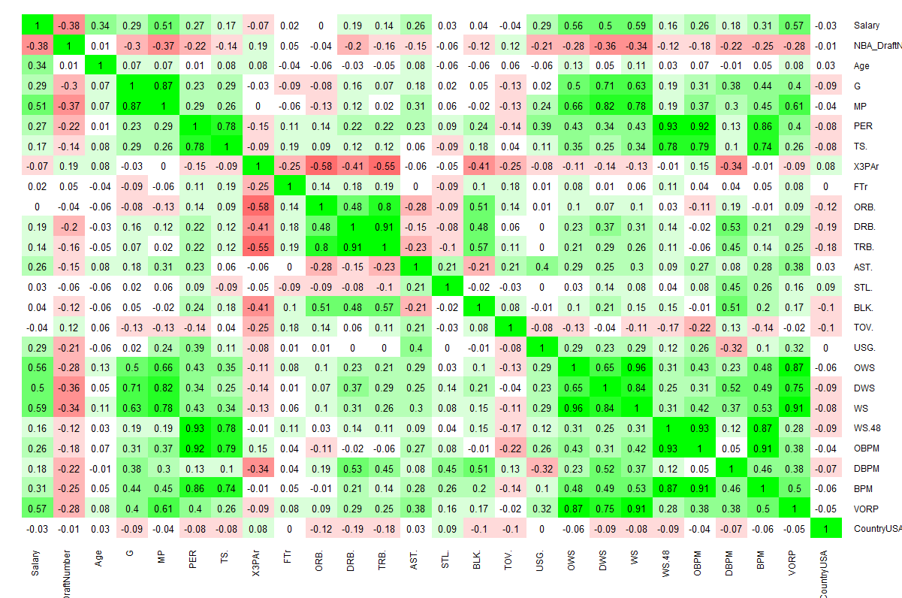
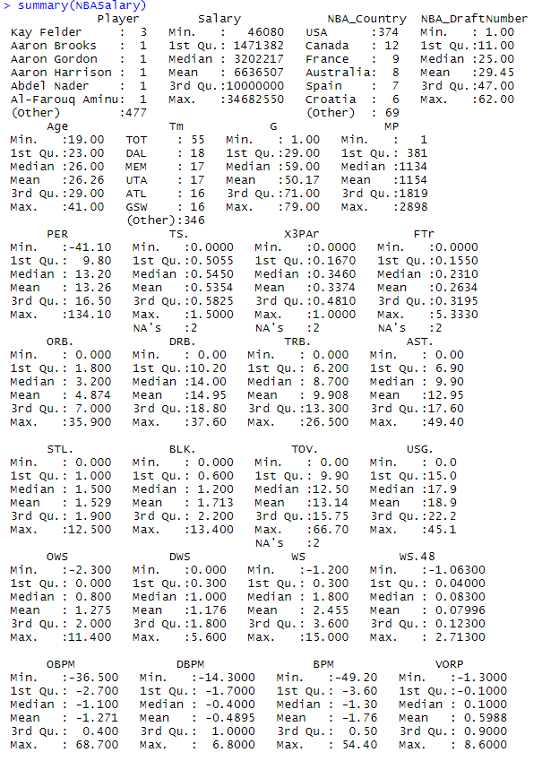
Preliminary Analysis
Original summary statistics
Correlation Table

Slide 5
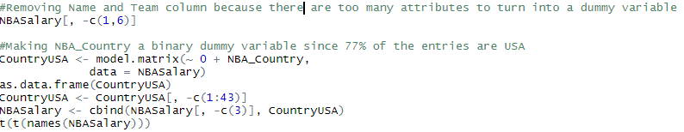
Preliminary Analysis (Cont.)
To prepare the data for our EDA, we have removed the categorical data that will not be relevant and turned any possible categorical data into binary variables.
4 variables have the strongest correlations. Their correlation coefficients are:
WS: 0.59
VORP: 0.57
OWS: 0.56
MP: 0.51

Slide 6
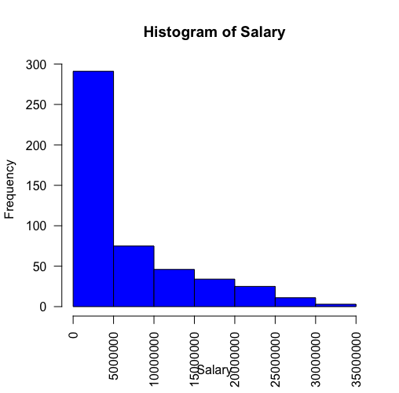
Histogram of Frequency of Salary
Most salary range for these players are under 5 millions.
Fewer than 50 make it into later bins making more 10 million.
Very few players make more than 30 million dollars

Slide 7
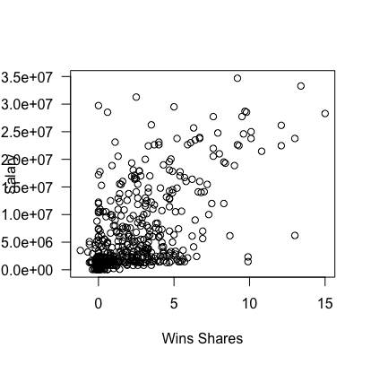
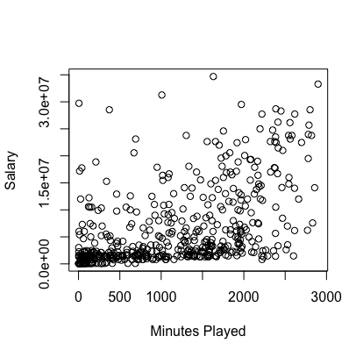
Scatter Plots of significant variables

Slide 8
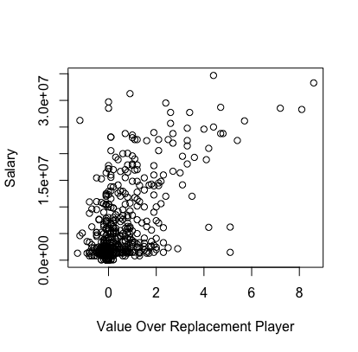
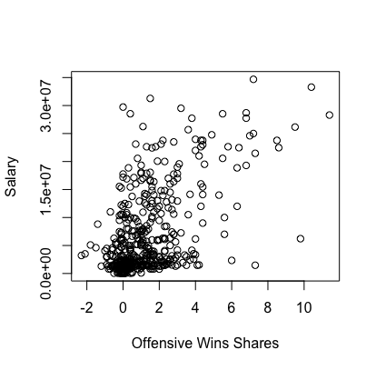
Scatter Plots of significant variables (cont)

Slide 9
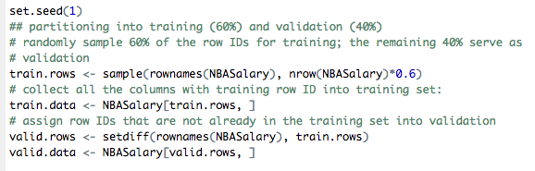

Building Regression Model
S1: We partitioned the data into 60% for Training Dataset and 40% Validation Dataset

Slide 10
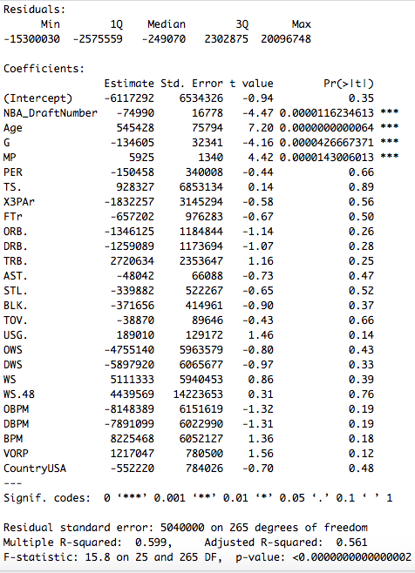
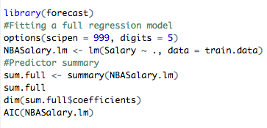
Building Regression Model
S2: We run the Regression Model on the training data
There are 26 predictors, 4 of which are significant at a .05 level
Rsquared = 0.599
Adjusted Rsquared = 0.561

Slide 11
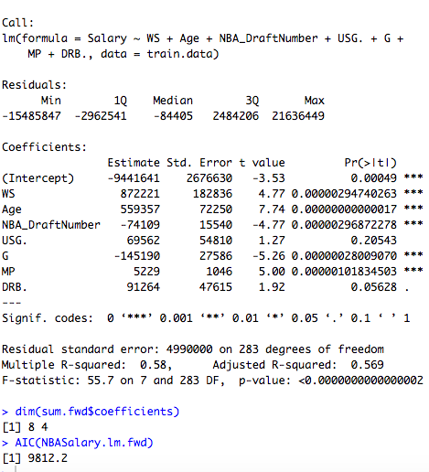
Forward Selection
The model resulting from forward selection resulting
In 7 predictors.
Rsquared = 0.58
Adjusted Rsquared = 0.569

Slide 12
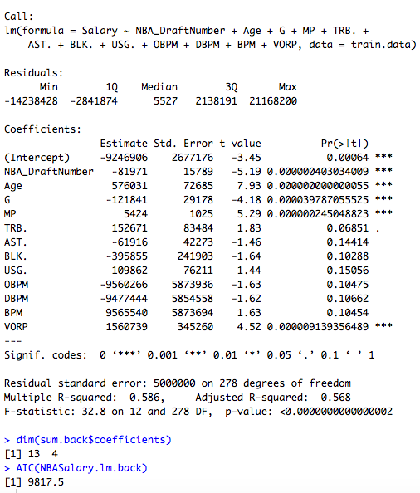
Backward Elimination
The model resulting from backward selection resulting
In 12 predictors.
Rsquared = 0.586
Adjusted Rsquared = 0.568

Slide 13
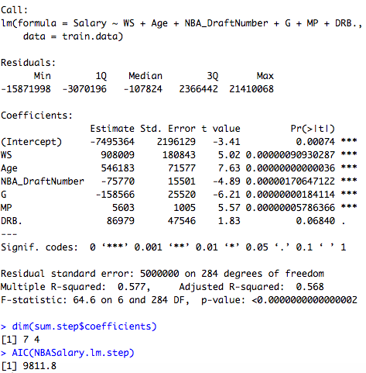
Stepwise Regression
The model resulting from stepwise selection resulting
In 7 predictors.
Rsquared = 0.577
Adjusted Rsquared = 0.568

Slide 14
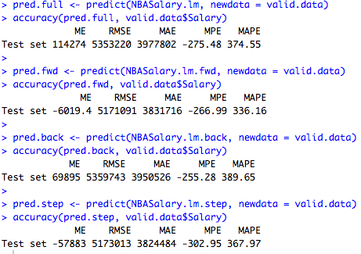
Comparison
Full model: 9834.7 AIC score
Forward Selection: 9812.2 AIC score
Backward Elimination: 9817.5 AIC score
Stepwise Regression: 9811.8 AIC score

Slide 15
Summary of Linear Regression
Out of all of the variable selection methods, forward selection and stepwise regression have the best in-sample prediction data(mainly AIC and Adjusted RSquared). But since we will be finding the best variable selection method compared to the regression we will be making, we will select the method has the best RMSE, which is forward selection. This is the best method and we’ll see if it’s better than the regression tree.

Slide 16
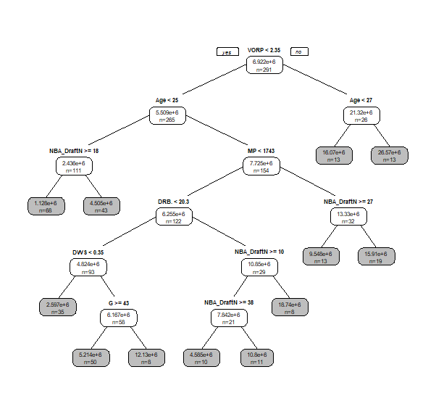

Regression Tree

Slide 17
Regression Tree vs Most Accurate Variable Selection Method
The regression tree is much easier to look at and doesn’t require much effort to find a good approximation. Other than the simplicity of it, the variable selection methods were all more accurate. The root mean squared error was much smaller for each variable selection method and full linear regression model than the regression tree. Since NBA players and agents would be looking for the most accurate algorithm to find salary predictions, forward selection would be the model to predict salary.

